Slide 1


Insert relevant picture related to the topic
ALGORITHMS AND DATA STRUCTURES
TEB1113/TFB2023
WEEK Va
STACK
FARAHIDA HANIM BT MAUSOR - DR (FSMC/UTP)
BACHELOR OF XXXXXX
DEPARTMENT OF COMPUTING
FACULTY OF SCIENCE, MANAGEMENT & COMPUTING
© 2026 INSTITUTE OF TECHNOLOGY PETRONAS SDN BHD
All rights reserved. No part of this document may be reproduced, stored in a retrieval system or transmitted in any form or by any means (electronic, mechanical, photocopying, recording or otherwise) without the permission of the copyright owner.

Slide 2
RECAP FROM PREVIOUS LECTURE
A circular linked list connects the last node back to the head.
Traversal stops when the pointer returns to the head.
Insertion and deletion require careful pointer updates.
Linked lists can be used to build other data structures.
Notes:
Learning Outcomes Slide
Note:
Include 2–4 lecture-level learning outcomes
Use measurable action verbs
Map explicitly to Course Learning Outcomes (CLOs)

Slide 3
LEARNING OUTCOMES
Explain Stack as a Last-In-First-Out ADT.
Trace push(), pop(), and peek() operations.
Identify stack overflow and underflow conditions.
Implement stack using arrays and linked lists in C++.
Notes:
Learning Outcomes Slide
Note:
Include 2–4 lecture-level learning outcomes
Use measurable action verbs
Map explicitly to Course Learning Outcomes (CLOs)

Slide 4
TOPICS
Stack Concept and Real-World Analogy
LIFO Principle
Core Stack Operations
Array-Based Stack Implementation
Linked-List Stack Implementation
C++ Lab Practice
Notes:
Learning Outcomes Slide
Note:
Include 2–4 lecture-level learning outcomes
Use measurable action verbs
Map explicitly to Course Learning Outcomes (CLOs)

Slide 5
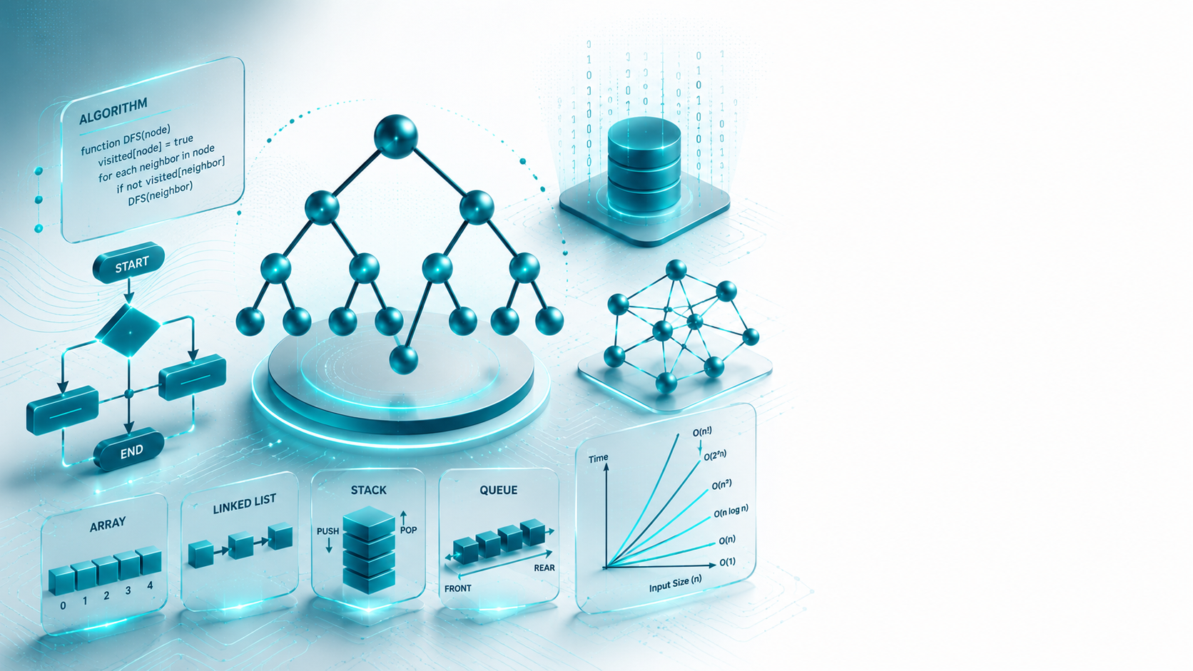
STACK
Introduction

Slide 6
INTRODUCTION
1.1. WHAT IS STACK?
A Stack is an Abstract Data Type (ADT) commonly used in most programming languages.
TOP → [ 30 ] ← remove first
[ 20 ]
[ 10 ] ← inserted first
Notes:
Engagement and Activity Slides
Note:
Include at least one engagement element where appropriate:
Think–Pair–Share
Mini task
Poll or reflection question
Suggested duration: 3–5 minutes
Activities shall align with learning outcomes

Slide 7
LIFO principle
This feature makes it a LIFO data structure. LIFO stands for Last-in-first-out.
Here, the element that is placed (inserted or added) last is accessed first.
In stack terminology, the insertion operation is called the PUSH operation, and the removal operation is called the POP operation.
A stack can be implemented using an Array, a Structure, a Pointer, and a Linked List.
A stack can either be a fixed-size one or it may have a sense of dynamic resizing.
Here, we are going to implement a stack using arrays, which makes it a fixed-size stack implementation.
Notes:
Summary and Closure Slides
Note:
Summarise 3–5 key takeaways
Reinforce main ideas
Indicate CLO coverage where appropriate
Include:
Upcoming topics
Required reading
Tutorial / lab / assessment linkage

Slide 8
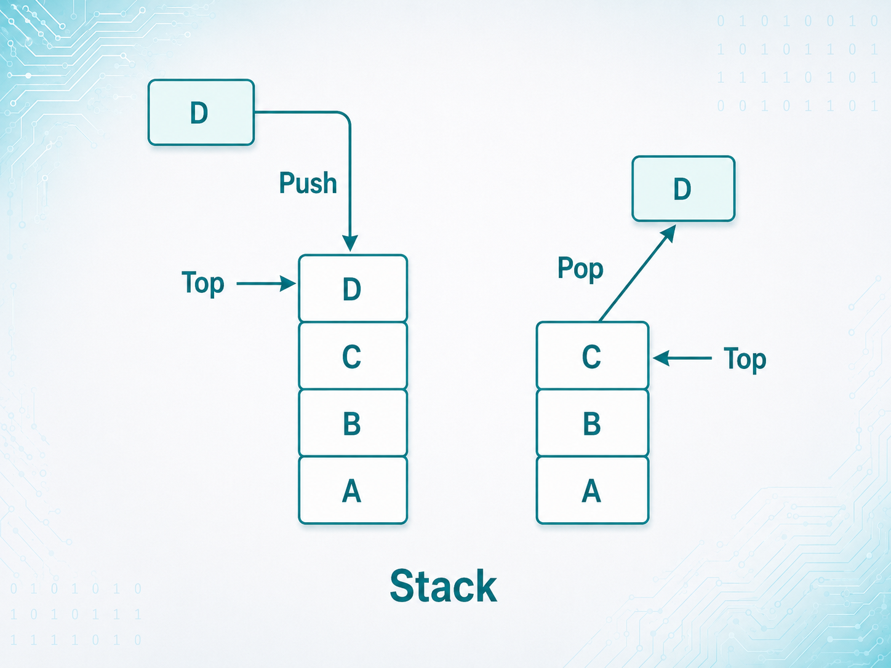
REPRESENTATION OF STACK
Notes:
Engagement and Activity Slides
Note:
Include at least one engagement element where appropriate:
Think–Pair–Share
Mini task
Poll or reflection question
Suggested duration: 3–5 minutes
Activities shall align with learning outcomes

Slide 9
SUMMARY
TODAY’S KEY TAKEAWAYS:
A stack is an ADT where access is allowed only at the top.
Stack follows LIFO: Last In, First Out.
push() inserts an item; pop() removes the top item.
peek() reads the top item without removing it.
Stacks can be implemented using arrays or linked lists.
Notes:
Engagement and Activity Slides
Note:
Include at least one engagement element where appropriate:
Think–Pair–Share
Mini task
Poll or reflection question
Suggested duration: 3–5 minutes
Activities shall align with learning outcomes

Slide 10
LAB TASK
CREATE A C++ PROGRAM
Part A: Array-Based Stack
push()
pop()
peek()
isFull()
isEmpty()
display()
Part B: Linked-List Stack
push()
pop()
peek()
isFull()
isEmpty()
display()
Notes:
Engagement and Activity Slides
Note:
Include at least one engagement element where appropriate:
Think–Pair–Share
Mini task
Poll or reflection question
Suggested duration: 3–5 minutes
Activities shall align with learning outcomes

Slide 11

THANK YOU
FARAHIDA HANIM BT MAUSOR - DR (FSMC/UTP)
DEPARTMENT OF COMPUTING
farahida.mausor@utp.edu.my
02-03-26

